Slide 1
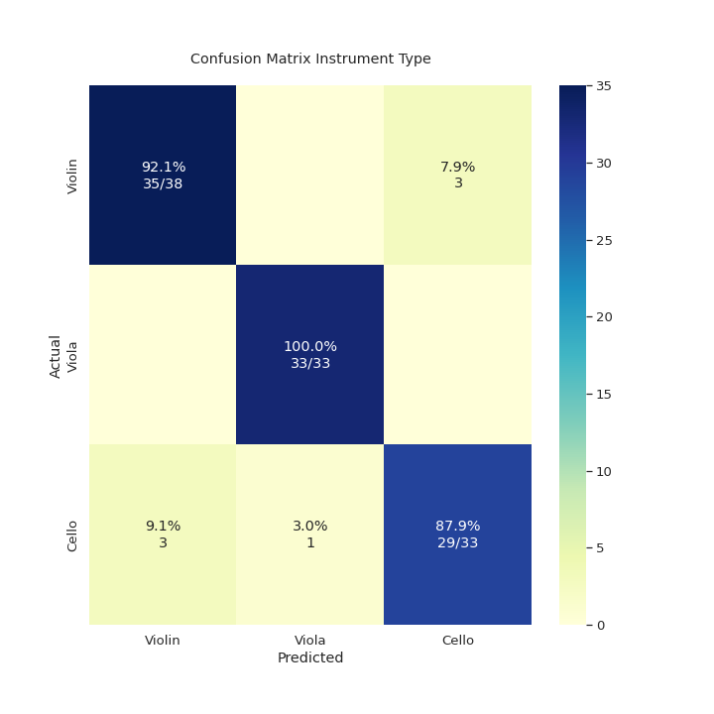
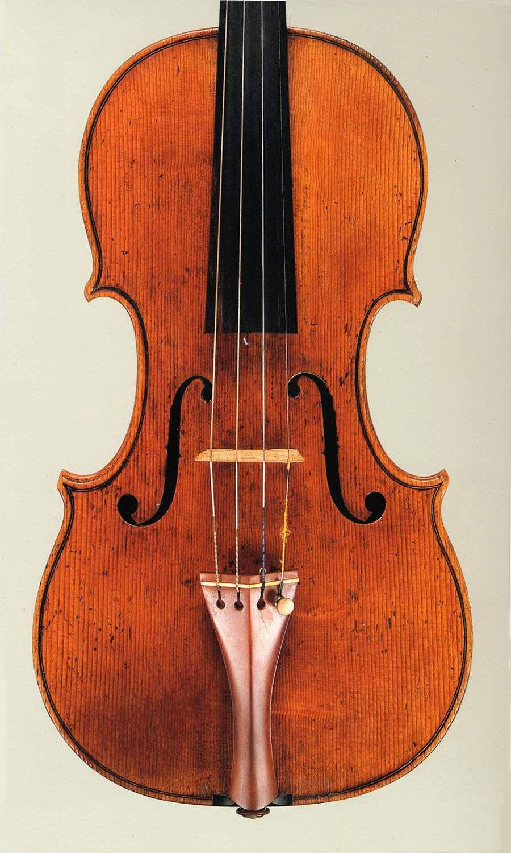
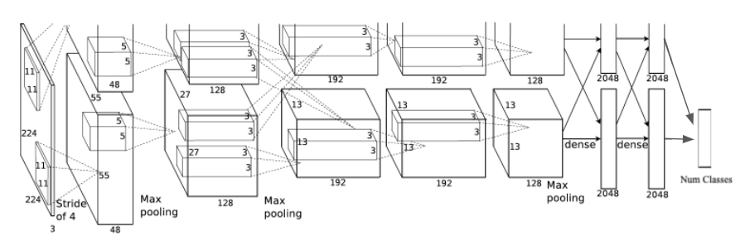
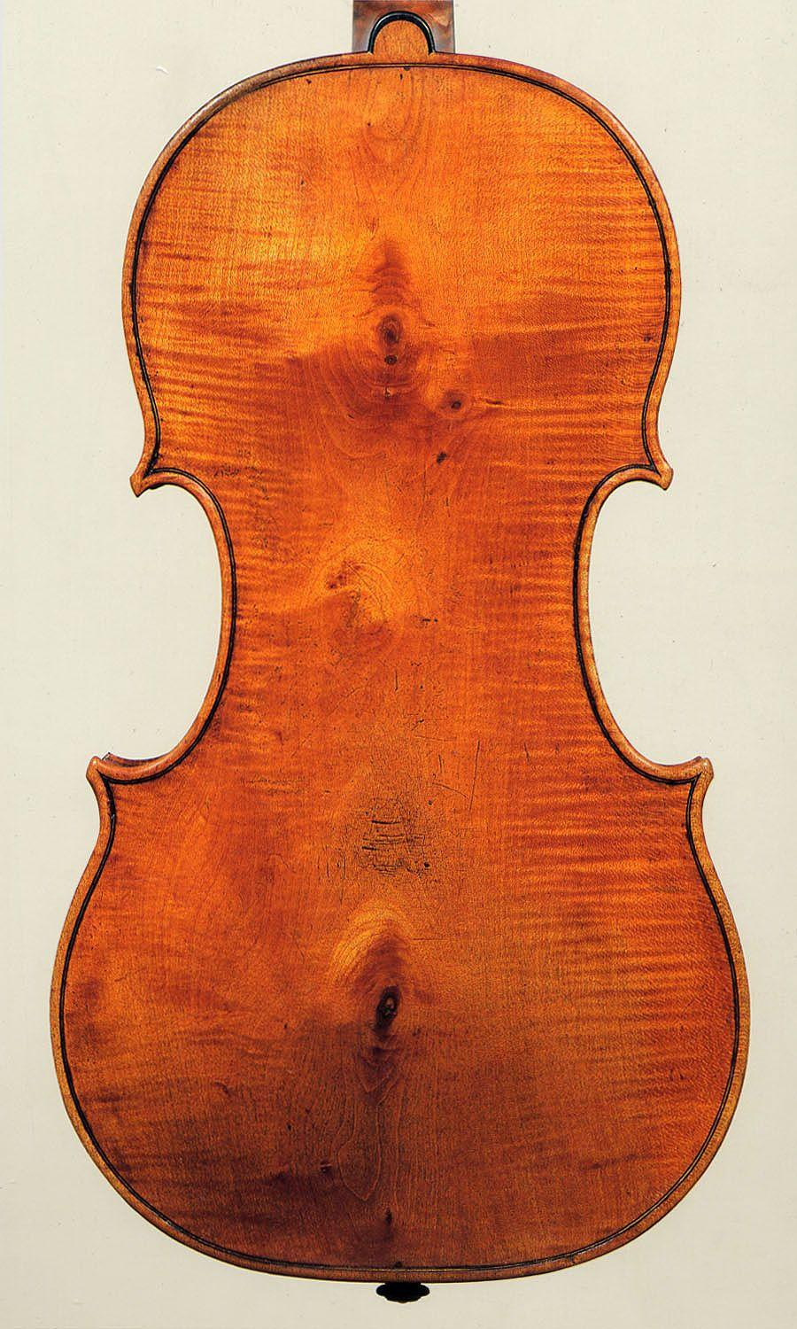
Using Transfer Learning for
Musical Instrument Classification
By Alex Chandler

Slide 2
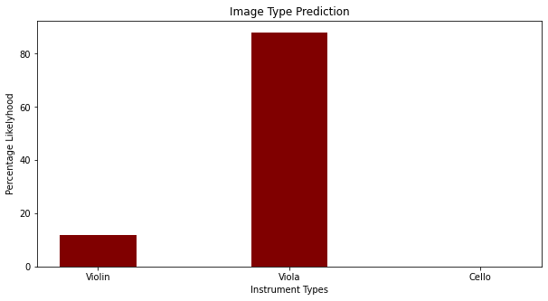
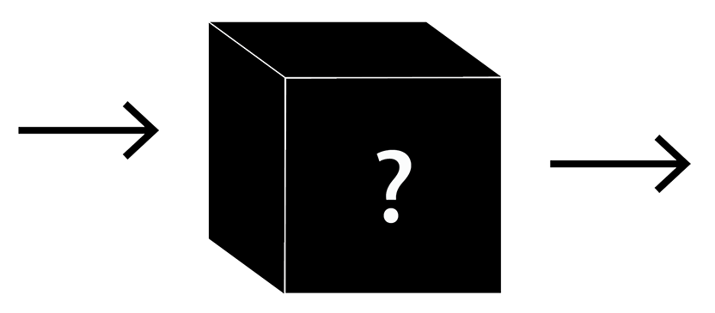
The Goal
Create models that can classify instruments
Classify by type (violin, viola, cello)
Classify by view (front or back)
Classify by country made (Italy, Germany, USA, France, Holland, Austria, etc.)
Input: Image of instrument, output: predicted category of instrument

Slide 3
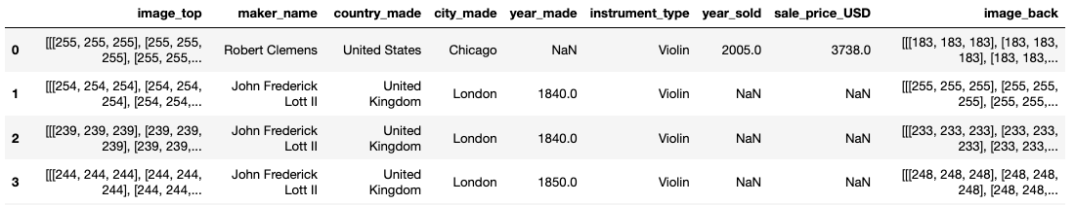
The Dataset and Image Processing
15,000 rows
Extremely Unbalanced Data
Missing Data

Slide 4
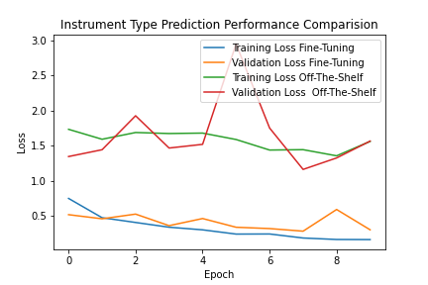
Model Creation and Training
Load pre-trained AlexNet (and other models)
Replace final layer with a new linear layer that outputs number of desired classes OR add linear layer to model that outputs number of desired classes
Fine-Tune model OR Freeze Pre-trained layers
Balance dataset (by removing frequent classes) OR use weighted loss for each class

Slide 5
Computational Experiments
Balanced Dataset versus Weighted Loss
Image Normalization
Off-the-Shelf versus Fine-Tuning
Testing Different Models
Creating Class Saliency Map to Detect Important Features
Notes:
Option 1: Global Standardization
Calculate the standard deviation and mean across all images per RGB channel, then use these values to standardize the pixel values for each image., preserves differences between images
Option 2: Local Standardization
Calculate the standard deviation and mean of one particular image per RGB channel, then use these statistics to standardize the pixels of the same particular image for each channel.

Slide 6
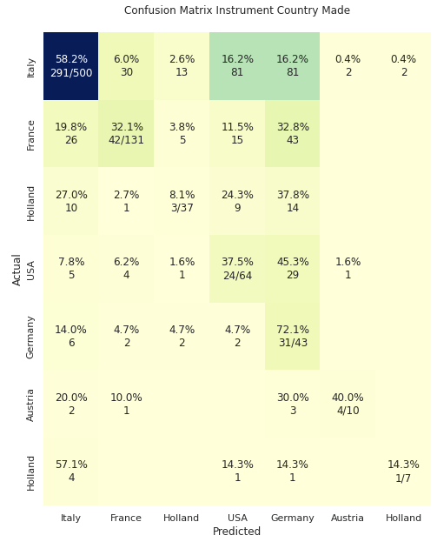
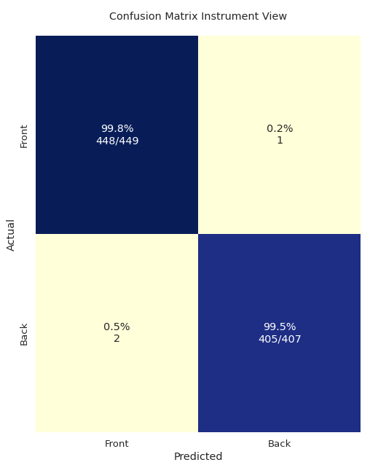
Testing and Results

Slide 7
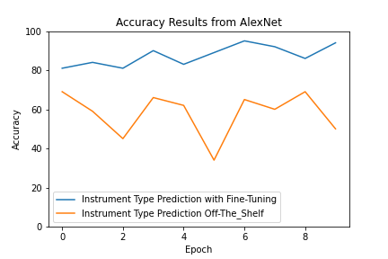
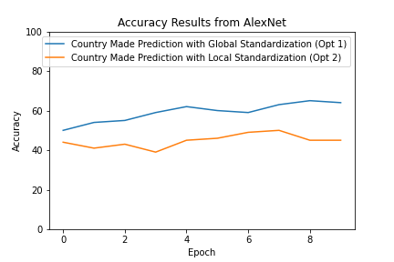
Accuracy Plots from Two Computational Tests

Slide 8
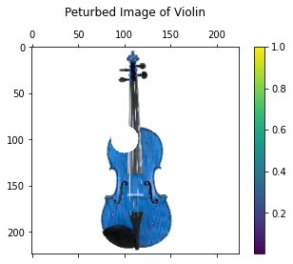
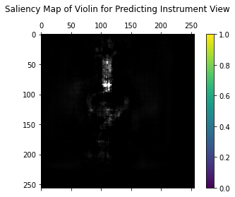
Class Saliency Maps

Slide 9
Conclusion
Future Work
CNNs perform well on classifying instrument type and view
AlexNet struggled to predict country made
Neck of instrument important for classification
Try transformers
Feed multiple views of instrument into model
Improve image processing
Gather larger database
Notes:
Predicting country made is hard: many makers around the world create nearly identical looking copies of old italian instrument.

